Slide 1

BITS WILP Smart AI Chatbot

Slide 2
Problem statement
To enhance the student experience and streamline academic support, we aim to build a Smart AI Chatbot tailored for the BITS Pilani Work Integrated Learning Program (WILP)
This chatbot will provide students with instant, 24/7 support for their academic and administrative queries, personalized learning resources, and seamless access to program information
It will leverage AI to offer context-aware responses, track students' learning progress, and provide tailored assistance to help them manage assignments, deadlines, and other academic activities efficiently

Slide 3
Market survey
Retrieval Augmented Generation (RAG) technique in AI is widely used solution by many organization to build Smart AI Chatbots for their custom data

Slide 4
Unique Selling Point(USP)
24/7 Accessibility
Comprehensive Academic Resource
Real-time Guidance
Time-Saving for Faculty and Support Staff

Slide 5
How it fills the gap
The BITS WILP Smart AI Chatbot can bridge significant gaps in the educational experience by addressing specific needs of students, faculty, and administrative staff.
Real-Time Student Support
Streamlined Administrative/Academic Queries

Slide 6
Future plans
Extend this solution to BITS on campus.

Slide 7
Application Architecture

Slide 8
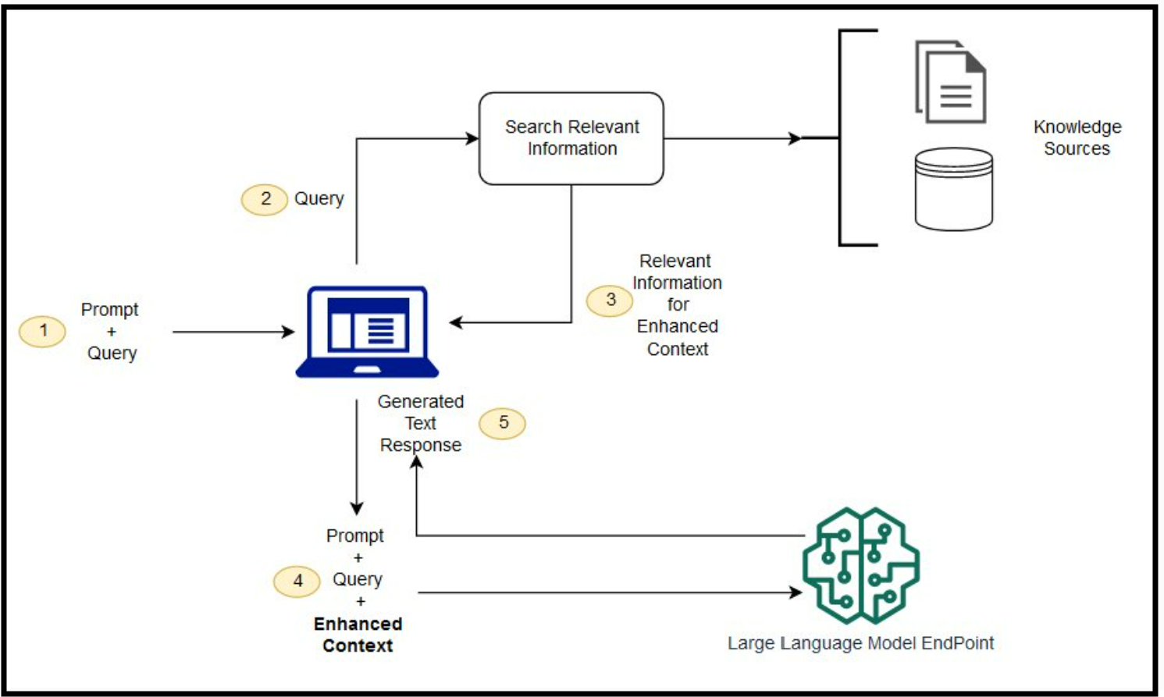
RAG Architecture

Slide 9
Benefits of our solution(AI, RAG and AWS Cloud)
Enhanced Relevance:
Incorporates external knowledge for more contextually relevant responses.
Efficient Retrieval:
Leverages existing knowledge bases, reducing the need for large labeled datasets.
Dynamic Updates:
Allows for real-time or periodic updates to maintain current information.
Cost Effective
Scalability
Availability

Slide 10
Demo

